Slide 1
C - PROGRAMMING INTERVIEW PREPARATION GUIDE

Slide 2
C PROGRAM COMPILATION STAGES:
Pre-Processing stage ( .c → .i )
Header files expanded
Macros will get replaced
Specific code will be included based on conditional macro’s
Comments will be removed
Compilation/Translation stage ( .i → .s )
Syntax and semantics analyses will be done
Reports errors if any which will help programmer to fix it.
Generates assembly code
Assembly stage ( .s → .o )
Assembly code converted into machine readable code.
Linking stage ( .o → .exe/.out )
Internal/External functions linkage will be done
Generates the architecture dependent executable file to execute

Slide 3
STORAGE CLASSES
C Memory Layout
S.No. | Storage Class Name | Storage | Initial value | Scope of the variable | Life of the variable
1 | auto | Stack Section | Garbage | Within function / Block | Within function / Block
2 | register | CPU Registers / Stack Section | Garbage | Within function / Block | Within function / Block
3 | local static | Data Section | 0 | Within function / Block | Till program exists
 | global static | Data Section | 0 | Within a file only | Till program exists
4 | extern | Data Section | 0 | Throughout a program | Till program exists
STACK
HEAP
DATA
CODE
Mapped to
RAM
.data
.bss
.rodata
Mapped to
Flash
Cannot declare static member as a structure variable
Structure variables can be declared as static
Functions can be declared as static
Its possible to declare const variable within a structure but needs to be initialized as soon as you declare variable for the structure.
Initialized variables
Uninitialized variables
String, assigned global will be stored here.
static const behaviour undecided

Slide 4
Modifiers
short
long
unsigned
signed
Qualifiers
const
Constant variable gets stored in different sections of the memory based on how you are declaring:
auto const variable will be stored in stack section and using pointer you can modify it.
Uninitialized static or global const variables will be stored in .bss section and using pointers you can modify it.
Initialized static or global const variables will be stored in RODATA section and using pointers you cannot modify it, it leads to SIGFAULT or crash.
Strings also gets stored in RODATA section.
volatile
Assume that there is a TEMP sensor which will sense the temperature data and its driver can read the data and write into some shared memory and there is an application which will display the whether condition on the screen by reading the data from that same shared memory.
These are 2 different programs and in application your program only reads this memory value so compiler will optimizes it to get better performance but we need always updated value from memory so to avoid optimization we will use volatile.
const volatile is also possible as we are not modifying the variable in that program.

Slide 5
Memory Corruptions
Global Memory Corruption
A global data can be corrupted due to Array index overflow from the previous data or Array index underflow from the next data.
Uninitialized pointers can also cause this issue.
To debug:
Put a write break point and debug it.
If no debug setup available then browse through the code to find if any previous or next data causing this.
Or else looking at the patterns what has written in your global location can also give you an idea.
Heap Memory Corruption
Corruption on the heap can be very hard to detect. A heap corruption could lead to a crash in heap management primitives that are invoked by memory management functions like malloc and free.
Reasons:
If a crash is observed in memory management primitives of the operating system, heap corruption is a possibility. It has been observed that memory buffer corruption sometimes leads to corruption of OS buffer linked list, causing crashes on OS code.
If a memory corruption is observed in an allocated buffer, check the buffers in the vicinity of this buffer to look for source of corruption.
Corruption of buffers close to heap boundary might be due to stack overflow or stack overwrite leading to heap corruption Conversely, stack corruption might take place if a write into the heap overflows and corrupts the stack area.

Slide 6
Stack Memory Corruption
Stack corruption is a phenomenon in which some memory locations at stack are accessed unintentionally due to wrong coding leading to change in values at those memory locations. Since the data corruption happens on stack memory locations, hence the term Stack Corruption. Reasons :
Due to bad written code, all the stack memory gets eaten up (like infinite function call)
Accessing array out of bounds.
An undefined/freed pointer pointing or storing a garbage stack address.
When due to some reason, the return address of a function call gets corrupted.
Dynamic Memory Use Cases
In most of the compilers, some extra bytes will be allocated for any dynamic memory allocations for book-keeping information like SIZE of the allocation, etc.
malloc( 0 ) returns atleast small chunk of memory (16B for example) which needs to be freed later.
malloc(-ve value) will try to allocate huge block and fails if memory is not available because malloc takes unsigned value and –ve value rounded to huge positive value.
free(ptr) looks for small chunk to find out SIZE of the allocated memory and frees it.
realloc (ptr, 0) also works as malloc (0).
Extra bytes for header | Actual requested SIZE

Slide 7
Note:
1) Size of a pointer is equal to size of ARCH-bit/8.
For example, for 64-bit machine, 64/8 = 8 bytes and for 32-bit, 32/8 = 4 bytes.
2) How to know the STACK is growing up/down?
main()
{
char x[2];
if((&x[1] - &x[0]) < 0 )
printf(“DOWN STACK\n”);
else
printf(“UP STACK\n”);
}
3) sizeof operator implementation:
#define SIZEOF(X) ({__typeof__(X) Y; ((char*)(&Y+1) - (char*)(&Y));})
4) Container of a structure variable:
#define CONTAINER_OF(ptr, type, member) ((type*) ((char*)ptr - (char*)&(((type*)0)->member)))

Slide 8
STRUCTURE:
Structure is an user defined data type which will keeps all the related data members of an entity into a single container.
For example PROCESS is an entity and its structure can be defined as below:
struct process
{ without struct padding With struct padding
uint32_t process_no;
uint32_t pp_no;
struct process *child_processes;
…
};
STRUCTURE PADDING:
By default any processor access the memory word by word.
For example, on 32-bit ARM processor memory will be accessed 4 bytes (1 word) at a time.
struct xyz
{
int x;
char y;
float z;
};
x0
x1
x2
x3
y0
z0
z1
z2
z3
x0
x1
x2
x3
y0
0
0
0
z0
z1
z2
z3
ARM

Slide 9
Bitfields:
Bitfields are used in the scenario where we use flag in our code and for that no need to waste lot of memory instead we can use few bits from the byte or word. We can save the memory with bitfields.
Declaration:
struct bitfield
{
char flag1:1;
char flag2:4;
}b;
To access them, we need to do bit-wise operations:
b.flag1 = 1;
b.flag2 = 0xC;
printf(“ %d %d \n”, (b.flag1 & 1), (b.flag2 & 0xF);
Typedef:
Using typedef we can give alias name to the existing/user defined data type to increase the readability and simplicity.
typedef struct linkedlist list;
list *Node;

Slide 10
UNIONS:
Unions will be used in the scenario where there are multiple members needed in the application for a same entity but all the members are mutual exclusion.
All the members share the common memory area where highest no. of bytes will be allocated for that union.
Ex:
union xyz
{
char x;
int y;
}u;
Enumerations or enums:
Enums are mainly used to assign names to integral constants, the names make a program easy to read and maintain.
enum week
{
Mon,
Tue,
Wed
..
}day;
day = Wed; ➔ it means day = 2 as enums value starts from 0, 1, 2, etc…
x0/y0 | y1 | y2 | y3

Slide 11
Arrays and Pointers
Pointers can hold the address of another variable or another pointer.
On pointer, we can do addition/subtraction/increment/decrement operations but not any other. It is meaningful to do these operations only on continuous memory locations.
With pointers we can access 1-D array memories but cannot access 2-D array memory by using pointer to pointer.
Array increment/decrement cannot be performed as array is constant pointer.
Combination of pointer and const :
char *p; → p is a pointer which will point to char variable
const char *p; → p is a pointer which will point to const char variable
char *const p; → p is a constant pointer which will point to char variable
const char *const p; → p is a constant pointer which will point to const char variable
Arrays of Pointers:
int *p[5] = { &x, &y, arr, &m, &n}
Pointer to Array:
int (*q)[5] = arr; ➔ Where arr is int arr[5]; array size must be 5 only.
int *p;
int **q;
int ***ptr;

Slide 12
int a[2][5] = { {1, 2, 3, 4, 5}, {11, 22, 33, 44, 55}};
int *ptr = (int*)a;
int (*ptr2)[5] = a;
printf(“%d %d\n”, *ptr, *(ptr + 1)); ➔ 1 2
printf(“%d %d\n”, **ptr2, **(ptr2 + 1)); ➔ 1 11
Below method will not give correct result using pointer to pointer
int **ptr1 = (int **)arr;
printf(“%d %d\n”, *ptr1, *(ptr1 + 1)); ➔ 1 3
=====
char *p = “Hello”;
int main( void )
{
char *q = “World”;
}
If you assign string to char array then that whole string will be copied into the array.
So, you can modify that string.
Ex: char str[10]=“Sat”;
*str[0] = ‘M’;
This is stored in RODATA section
This is stored in .data section
This is stored in RODATA section
This is stored in stack section

Slide 13
Operations performed during function call:
Push calling functions register values into the stack frame
Update the link register(LR) with the return address
Update the general purpose registers(R0-R4 based on compiler and system) with the actual values of the called functions.
Make a function call and create its stack frame.
Push formal arguments to the stack frame from registers.
Do the operations and return back using the address stored in LR.
Reload the registers from stack frame and do the normal operations.
INLINE function:
Inline function must be declared with static keyword.
Ex:
static inline func(void)
{
}
Diff b/w macro’s and inline functions:
Macro’s will be expanded in preprocessing stage and inline will be replaced in a code during compilation stage.
Macros will not do any type checking but inline functions will do it.

Slide 14
Which one is good normal function or inline function:
Its based on the requirement.
Normal function always creates stack frame and destroys it once done and lot of other operation takes place which will consume lot of CPU cycles. And it won’t give better performance compared to inline functions.
But, with normal function call memory footprint will be less.
Where as inline function will be expanded during compilation itself so memory footprint will be more.
But, it gives better performance as there is no CPU cycles wasted during execution.
Note: Formal parameter of the functions can be declared with register storage class only.
Bit-wise operations:
Set bit : n = n | ( 1 << bit )
Reset bit: n = n & ~ ( 1 << bit )
Toggle bit: n = n ^ ( 1 << bit )
Check if k^{th} bit is set or reset: if( n & (1 << k) != 0) then set else reset
Nibble swap in a byte: n = (n & 0xF0 >> 4) | (n & 0x0F << 4)
Little to big endian or vice-versa(32-bits):
n = ( n & 0xFF000000 >> 24) | ( n & 0x000000FF << 24) | ( n & 0x00FF0000 >> 8) | ( n & 0x0000FF00 << 8)
System is Little endian or big endian
int x = 0x1;
if((char)x & 1)
printf("Little Endian\n");
else
printf("Big Endian\n");

Slide 15
Given no. is power of 2 or not : if(n & (n – 1) == 0) then power of 2
Given no. is power of 4 or not: (1) it should be power of 2 .
(2) c = 0; while((n & 1) == 0) { c++; n >>= 1;} if(c%2 == 0) then power of 4
Given no. is even or odd: if(n&1 == 0) then EVEN else ODD
Reverse the bits of a given number: for(i = 0, j = 31; i<j; i++, j--) { if( !(n & ( 1 << i)) != !(n & (1 << j))) then toggle both bits
Check if the given no. is –ve : if((n >> 31) & 1 ) == 1) then –ve
Add 1 to the given no. : x = -(~x);
Swap 2 no. using bit-wise: x = x^y; y = x^y; x = x^y;
Explore on below questions:
Difference b/w strcpy/memcpy/memmove
Swap 2 variables without 3rd variable (x = x+y; y= x-y; x = x-y;)
Implement all the string functions like strcat/strchr/strcmp/strcpy/strlen/strncat/strncmp/strncpy/strlcpy/strlcat/strrchr/strstr
Implement sorting algorithms ( Bubble sort/Selection sort/Insertion sort/Quick sort/Merge sort)
Implement searching algorithms ( Linear/Binary search)
Implement binary to decimal
Implement decimal to binary (-ve also)
Note: Solve as many as questions from
https://blog.usejournal.com/500-data-structures-and-algorithms-practice-problems-35afe8a1e222?gi=fbe293767db9

Slide 16
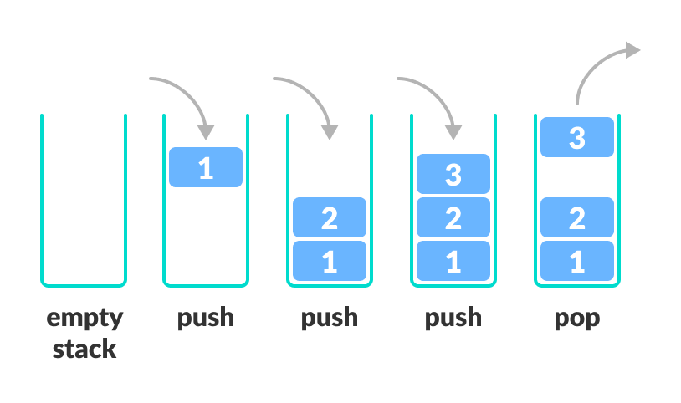
DATA STRUCTURE
STACKS
A stack is a linear data structure, collection of items of the same type.
Stack follows the Last In First Out (LIFO) fashion wherein the last element entered is the first one to be popped out.
The following are the basic operations served by the Stacks.
IsEmpty: Checks whether the stack is empty.
IsFull: Checks whether the stack is full.
Push: This function adds an element to the top of the Stack.
Algo:
PUSH
begin
check IsFull
Cannot push elements & return
push element into the top of the stack
end
Pop: This function removes the topmost element from the stack.
Algo:
POP
begin
check IsEmpty
Cannot pop elements from the stack & return
pop the elements from the top of the stack
end
Pip: Displays the topmost element of the stack.
Algo:
PIP
if not empty return the top elements

Slide 17
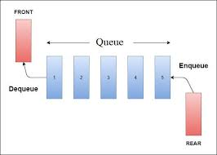
QUEUE
A Queue is a linear data structure which follows a particular order in which the operations are performed.
The order is First In First Out (FIFO).
The following are the basic operations served by the Stacks.
Insert: This function adds elements into the queue.
Algo:
INSERT
begin
check if Queue is full
Cannot insert the elements & return
insert the elements into the queue at rear end
end
Delete: This function deletes elements from the queue.
Algo:
DELETE
begin
check if Queue is empty
Cannot delete elements from the queue
Remove element from the queue at front end
end

Slide 18
Single Linked List:
A linked list is a linear data structure, in which the elements are not stored at contiguous memory locations.
Declaration of single linked list:
struct list
{ NODE
int data;
struct list *next;
};
Insert the element at the beginning of the list
Insert the element in the middle of the list
Insert the element at the end of the list
Delete the first node from the list
Delete the middle node from the list
Delete the last node from the list
Data | Next
Head
Data | Next
Data | Next
Data | Next
Data | Next
Data | Next
Struct declaration for generic linked list:
struct list
{
void *data;
struct list *next;
}

Slide 19
Questions on the linked list, stacks and queues:
Reverse the single linked list
Reverse the double linked list
How do you reverse a linked list without using any C pointers?
Given only a pointer to a node to be deleted in a singly linked list, how do you delete it?
How would you detect a loop in a linked list?
How do you find the middle of a linked list?
Write a C program to return the n^{th} node from the end of a linked list
Implement stack using linked list
Implement queue using linked list
Implement queue using stack
Find the common node between the 2 lists.
Implement Queue by using Stack.
File Operations:
Creating a file, reading, writing a file
Reading files from directory recursively and searching a particular string in it
Print the count of that string present in each file and total count in the directory.

Slide 20
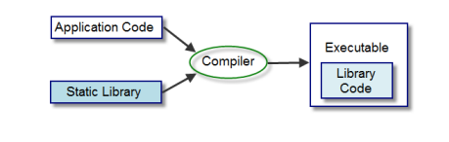
What is a C Static Library?
In the C programming language, a static library is a compiled object file containing all symbols required by the main program to operate (functions, variables etc.) as opposed to having to pull in separate entities.
Static libraries needs to provided during compile time so that

Slide 21
THANK YOU…

